Slide 1
Big Data Fundamentals

Slide 2
https://www.simplilearn.com/big-data-applications-in-industries-article

Slide 3
What is Big Data?
Big data is a term that describes the
large volume of data
both structured and unstructured
that overwhelms a business on a day-to-day basis.
Big data can be analyzed by organizations for insights that lead to better decisions and strategic business moves.

Slide 4
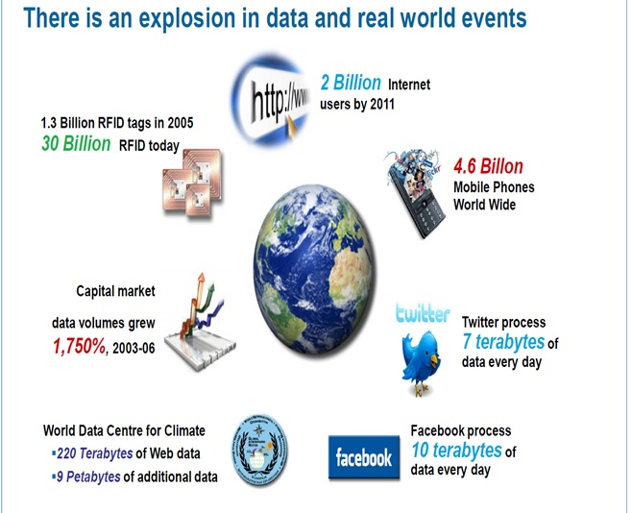

Slide 5
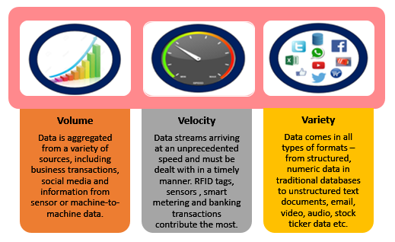
3V’s of Big Data
Volume - too big
terabytes and more. [of credit card transactions, web usage data, system logs]
Velocity - too fast
sensor data, live web traffic, mobile phone usage, gps data
Variety - too complex
Structured, truly unstructured data such as social media, customer reviews, call centre records
Notes:
http://www.pavantestingtools.com/2016/10/scope-of-testing-in-big-data-and-hadoop.html

Slide 6
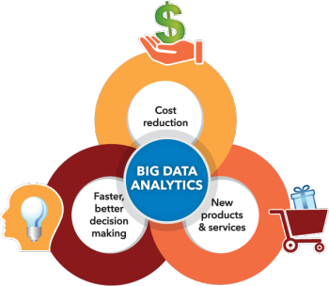
Why is big data important?
You can take data from any source and analyze it to find answers that enable
cost reductions, 2) time reductions,
3) new product development and optimized offerings
4) smart decision making.
When you combine big data with high-powered analytics, you can accomplish business-related tasks such as:
Determining root causes of failures, issues and defects in near-real time.
Generating coupons at the point of sale based on the customer’s buying habits.
Recalculating entire risk portfolios in minutes.
Detecting fraudulent behavior before it affects your organization.
Notes:
https://www.sas.com/en_us/insights/big-data/what-is-big-data.html
https://www.snp.com/blog/8-ways-data-analytics-can-improve-your-business

Slide 7
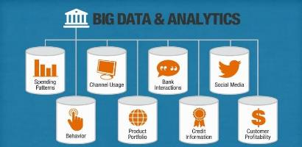
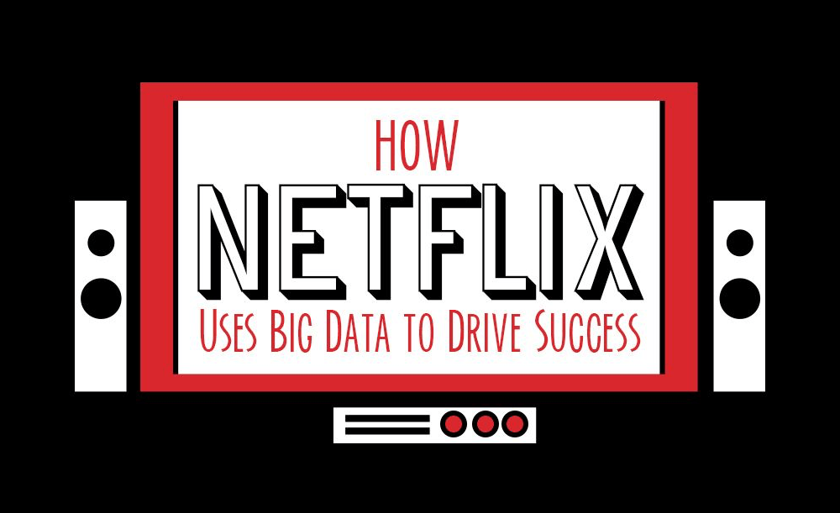
Applications of Big data
Government operation: national archives and records
administration, census bureau
Commercial: finance in cloud, cloud backup, netflix, web search, digital materials, cargo shipping (as in UPS)
Defense: sensors, image surveillance, situation assessment
Notes:
https://martech.zone/netflix-big-data/
https://www.norjimm.com/blog/7-ways-big-data-analytics-changing-hotels-travel-industry/

Slide 8
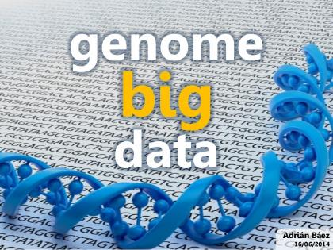
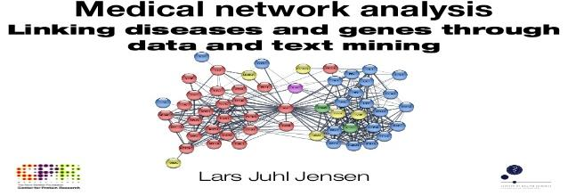
Applications of Big data
Healthcare and life sciences: medical records, graph and probabilistic analysis, pathology, bioimaging, genomics, epidemiology, people activity models, biodiversity
Deep learning and social media: driving car, geolocate images/cameras, twitter, crowd sourcing, network science
Notes:
https://www.itweb.co.za/content/Gb3Bw7Wo1Ow72k6V

Slide 9
Who uses big data?
Big data affects organizations across practically every industry..
Banking
With large amounts of information streaming in from countless sources, banks are faced with finding new and innovative ways to manage big data.
While it’s important to understand customers and boost their satisfaction,
it’s equally important to minimize risk and fraud while maintaining regulatory compliance.
Education
Educators armed with data-driven insight can make a significant impact on school systems, students and curriculums.
By analyzing big data, they can identify at-risk students, make sure students are making adequate progress, and can implement a better system for evaluation and support of teachers and principals.

Slide 10
Who uses big data?
Government When government agencies are able to harness and apply analytics to their big data, they gain significant ground when it comes to managing utilities, running agencies, dealing with traffic congestion or preventing crime.
Health Care Patient records. Treatment plans. Prescription information. When it comes to health care, everything needs to be done quickly, accurately.
When big data is managed effectively, health care providers can uncover hidden insights that improve patient care.

Slide 11
Who uses big data?
Manufacturing
Armed with insight that big data can provide, manufacturers can boost quality and output while minimizing waste – processes that are key in today’s highly competitive market. More and more manufacturers are working in an analytics-based culture, which means they can solve problems faster and make more agile business decisions.
Retail
Customer relationship building is critical to the retail industry – and the best way to manage that is to manage big data.
Retailers need to know the best way to market to customers, the most effective way to handle transactions, and the most strategic way to bring back lapsed business.
Big data remains at the heart of all those things.

Slide 12

Track Resources
Download the CTP for SQL Server 2014 and accelerate your queries using In-Memory OLTP - http://technet.microsoft.com/en-us/evalcenter/dn205290.aspx
Get into the cloud with an Azure account - use SQL database in Windows Azure or take your workload into Azure VM - www.windowsazure.com
Get big with big data – HDInsight on Azure and grab the latest Power BI features http://www.windowsazure.com/en-us/documentation/services/hdinsight/?fb=en-us Power BI - www.powerbi.com

Slide 13
1. https://www.youtube.com/watch?v=zez2tv-bcxy
Big Data Tutorial For Beginners | What Is Big Data | Big Data Tutorial | Hadoop Training | Edureka
2. https://www.youtube.com/watch?v=tkowlxuagmm&t=324

